Slide 1
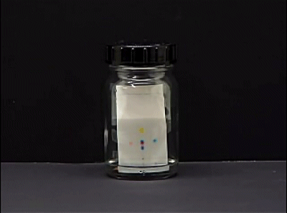
Experiment 1 Thin-Layer Chromatography
實驗目的:
瞭解色層分析的應用以及其操作。
分析沖提液極性大小對於不同極性化合物的影響。

Slide 2
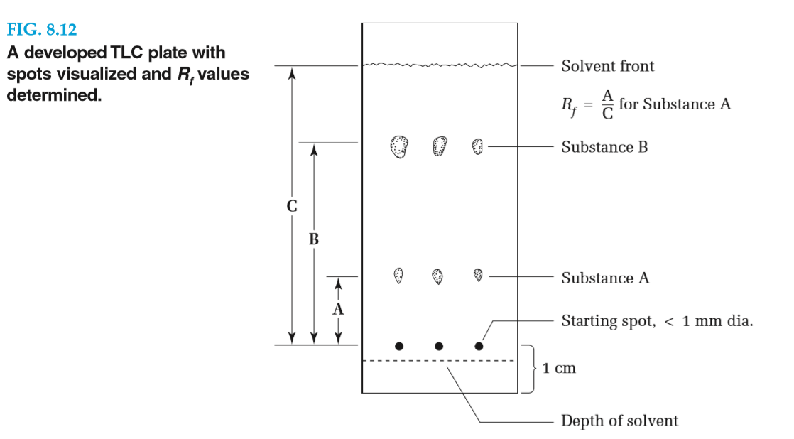
Questions
4. In what order (from top to bottom) would you expect to find naphthalene, butyric acid, and phenyl acetate on a silica gel TLC plate developed with dichloromethane?
5. In carrying out an analysis of a mixture, what do you expect to see when the TLC plate has been allowed to remain in the developing chamber too long, so that the solvent front has reached the top of the plate?
7. What will be the result of applying too much compound to a TLC plate?
9. What will be the appearance of a TLC plate if a solvent of too low polarity is used for the development? A solvent of too high polarity?
12. Using a ruler to measure distances, calculate the R_{f} value for substance B in Figure 8.12.

Slide 3
4. In what order (from top to bottom) would you expect to find naphthalene, butyric acid, and phenyl acetate on a silica gel TLC plate developed with dichloromethane?
Ans: Naphthalene, a nonpolar hydrocarbon, will be at the top of the plate (have the largest R_{f} value) while the highly polar butyric acid will be strongly attracted to the adsorbent and have the lowest R_{f} value. The ester, phenyl acetate, will be in between.

Slide 4
5. In carrying out an analysis of a mixture, what do you expect to see when the TLC plate has been allowed to remain in the developing chamber too long, so that the solvent front has reached the top of the plate?
Ans: The spots will grow larger as the compounds diffuse in all directions. If the solvent does not evaporate from the top of the plate, the R_{f} values should not be affected.

Slide 5
7. What will be the result of applying too much compound to a TLC plate?
Ans: The spots of various components will overlap to the point where the number of different components cannot be ascertained.

Slide 6
9. What will be the appearance of a TLC plate if a solvent of too low polarity is used for the development? Asolvent of too high polarity?
Ans: If a solvent of too low polarity were used, the components would stay adsorbed to the silica gel and would not move from the starting point. If the solvent polarity were too high, the components in the mixture would dissolve readily in the solvent and travel with the solvent front.

Slide 7
12. Using a ruler to measure distances, calculate the R_{f} value for substance B in Figure 8.12.
Ans: The solvent traveled 50.5 mm and Substance B traveled 36.5 mm, so the R_{f} of B is 36.5/50.5 = 0.72.

Slide 8
1.寫下跑TLC片的程序依序有哪七項(至少五項) 。 Write the procedure of running the TLC in order (at least 5 steps) 2.在跑片槽裡放濾紙的目的 What is the purpose of the filter paper inside the chamber ? 3.跑液極性的選擇應以重要化合物跑出之R_{f}值約落在多少為最佳? What is the optimal R_{f} value for being the accordance of elution selecting? 4.化合物極性越大其跑片結果之R_{f}值越? (大/小) 跑液(流動相)極性越大對同化合物跑片結果之R_{f}值越?(大/小) The bigger polarity of compound is, the higher/lower R_{f} value you’ll obtain from the result. The bigger polarity of elution(mobile phase) is, the higher/lower R_{f} value you’ll obtain from the result.

Slide 9
Experiment 2 Distillation and Boiling Point
實驗目的
1.加熱板控溫技巧。
2.學習分餾裝置及操作。

Slide 10
Questions
8. Why is it extremely dangerous to attempt to carry out a distillation in a completely closed apparatus (one with no vent to the atmosphere)?
9. Why is better separation of two liquids achieved by slow rather than fast distillation?
13. When water-cooled condensers are used for distillation or for refluxing a liquid, the water enters the condenser at the lowest point and leaves at the highest. Why?
EXTRA Q1那些因素可以影響分餾效果。

Slide 11
8. Why is it extremely dangerous to attempt to carry out a distillation in a completely closed apparatus (one with no vent to the atmosphere)?
Ans: The application of heat to a cold, sealed, distillation apparatus will cause the gas in the apparatus (primarily air) to expand and build pressure, which may cause the apparatus to come apart. A distillation in progress can, of course, be sealed from the atmosphere because no vapor should escape from the apparatus.

Slide 12
9. Why is better separation of two liquids achieved by slow rather than fast distillation?
Ans: The equilibrium between ascending vapor and descending liquid is not established instantaneously. A slow distillation allows time for this equilibrium to become established.

Slide 13
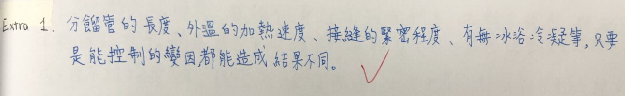
13. When water-cooled condensers are used for distillation or for refluxing a liquid, the water enters the condenser at the lowest point and leaves at the highest. Why?
Ans: If the water entered the condenser at the top it is possible for it to run down the inside of the condenser and not make contact with the inner tube containing the hot vapors to be condensed.
EXTRA Q1那些因素可以影響分餾效果。

Slide 14
EXP 2 小考題目
(40%) 請畫出分餾裝置圖 (夾子、溫度計、止洩帶、冷凝管的水流向、封口夾、氣球、冰浴水量) Draw a diagram of the fractionation device (including clip, thermometer, thread seal tape, water flow direction of the condenser, sealing clip, balloon, water volume of the ice bath)
(20%) 請簡述簡單蒸餾和分餾的差別 (至少寫出兩種差別) Briefly describe the difference between simple distillation and fractionation (at least two differences)
(15%)請劃出溫度計最適當的位置 Draw the most appropriate position of the thermometer
(15%)出入水口下進下出的原因The reason of water in and out from lower to higher position.
(10%)不加攪拌石到蒸餾瓶中，容易發生何種現象? What kind of phenomenon is easy to happen without adding a stir bar to the distillation flask?

Slide 15
Experiment 3 Recrystallization
實驗目的
1.尋找適當的溶劑。
2.單溶劑再結晶與雙溶劑再結晶的選擇及差異?
3.再結晶的標準步驟。

Slide 16
Questions
6. Why is gravity filtration rather than suction filtration used to remove suspended impurities and charcoal from a hot solution?
9. Why is the final product from the recrystallization process isolated by vacuum filtration rather than gravity filtration?
EXTRA Q1進行實作後，哪些步驟會影響再結晶成敗，其因素是什麼? (可條列或表格)
EXTRA Q2請問造成熔點不準的原因，為什麼?

Slide 17
6. Why is gravity filtration rather than suction filtration used to remove suspended impurities and charcoal from a hot solution?
Ans: During suction filtration of a hot solution, evaporation of the solvent takes place with attendant evaporative cooling. The combination of these two effects causes crystals to form and clog the Büchner or Hirsch funnel.
9. Why is the final product from the recrystallization process isolated by vacuum filtration rather than gravity filtration?
Ans: Vacuum filtration is a much more efficient method for removing solvent from the crystals than is gravity filtration.

Slide 18
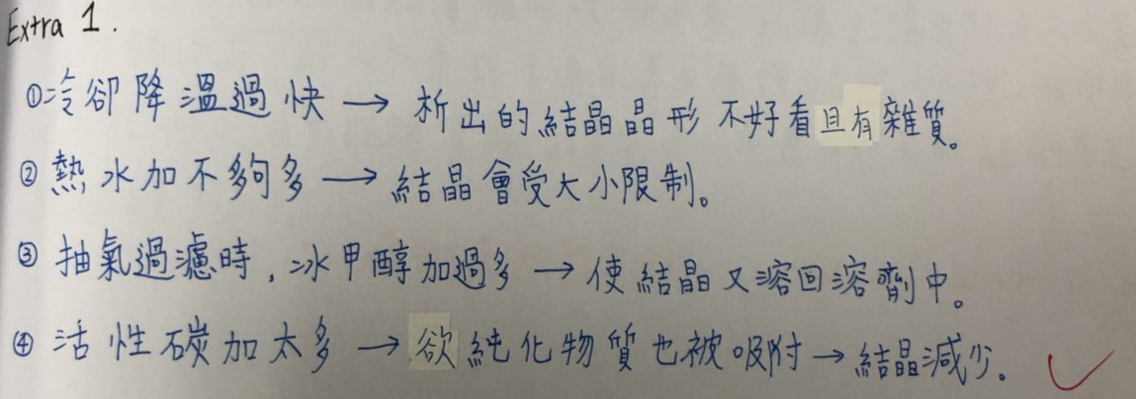
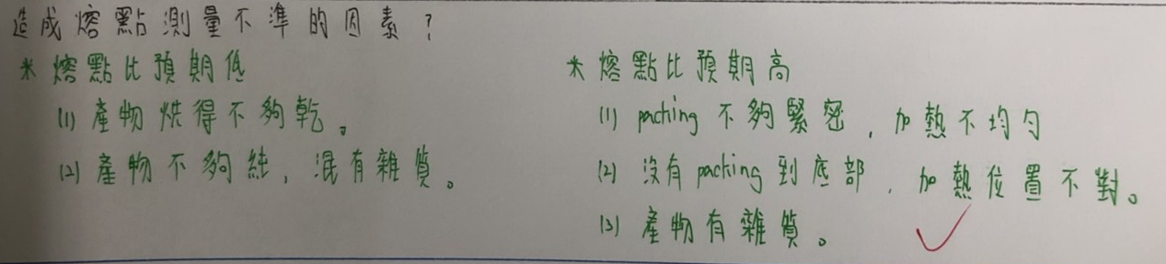
EXTRA Q1進行實作後，哪些步驟會影響再結晶成敗，其因素是什麼? (可條列或表格)
EXTRA Q2請問造成熔點不準的原因，為什麼?

Slide 19
再結晶問題回答：
所需再結晶的有機溶劑需要用何種容器裝盛? 如何加熱? 為什麼? What kind of container you need to contain the organic solvent that used in recrystallization? How to heat? Why?(10%/10%/10%)
可否於溶液沸騰時加入活性碳?為什麼? Is it OK to add activated carbon when the solution is boiling? Why?(10%/10%)
在晶體還沒要析出前，實驗中儘量避免碰觸冷的容器或溶劑，是為了避免甚麼? Before the crystal has yet to be precipitated, try to avoid touching the cold container or solvent in the experiment. What is it in order to prevent from?(10%)
等待晶體析出時應該要注意甚麼?請劃出抽氣過濾裝置。 What should you pay attention to when waiting for crystal precipitation? Please draw a device of suction filter?(10%/20%)
過濾晶體時應該要注意甚麼? What should you pay attention to when filtering crystals?(10%)

Slide 20
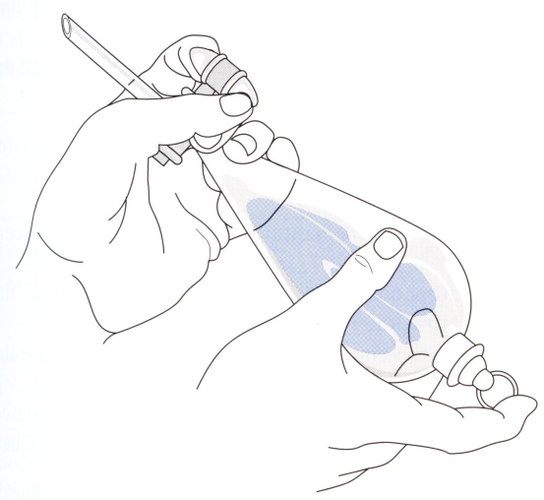
Experiment 4 Extraction
Separations Based upon Acidity (Basicity)
實驗目的
(酸)鹼萃取分離法
萃取技巧
乳化的處理
乾燥劑的選擇與移除
使用旋轉濃縮儀

Slide 21
Questions
(page 168)
8. Draw a flow sheet to show how you would separate the components of a mixture containing an acid substance, toluic acid, a basic substance, p-bromoaniline, and anthracene, a neutral substance.
Extra Q1
在萃取實驗過程中，有某生不確定哪一層是有機層，請問你該如何幫助他解決次問題?
Extra Q2
以下是某市售藥錠的主要成分及物理性質，若要單離出咖啡因的話，應該如何進行? 每項分離原因或理由都須標明!
1) Ethenzamide…300mg ：易溶於二氯甲烷、乙醇、丙酮，難溶於水、乙醚。
2) Acetaminophen…200mg：微溶於水及乙醚，溶於酒精。
3) Bromvalerylurea…100mg：溶於醇、醚、丙酮，不溶於冷水，易溶於熱水，不溶於氯仿。
4) Caffeine…120mg：溶於二氯甲烷，微溶於水及酒精，極微溶於乙醚。
Extra Q3
如何確認在萃取實驗中有完全萃取乾淨，以避免造成產率損失?

Slide 22
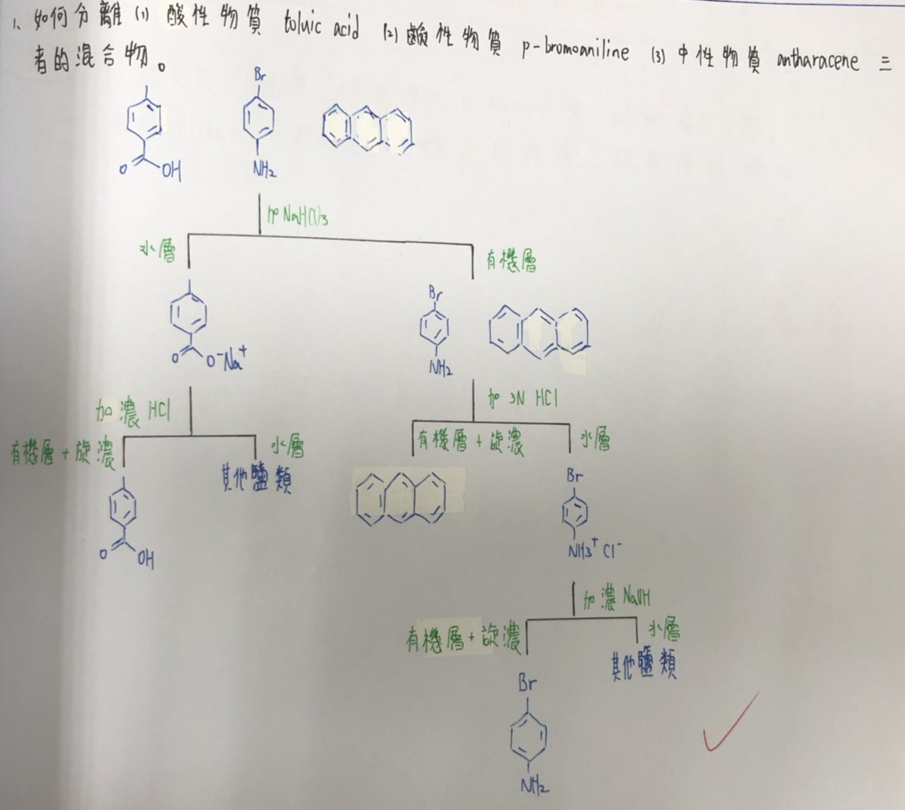
8. Draw a flow sheet to show how you would separate the components of a mixture containing an acid substance, toluic acid, a basic substance, p-bromoaniline, and anthracene, a neutral substance.

Slide 23
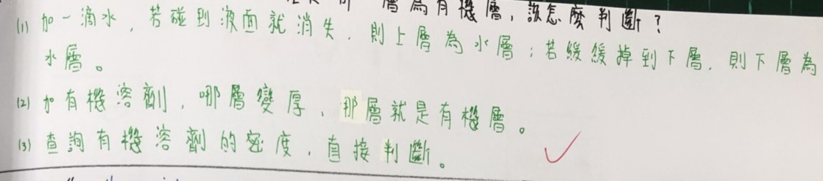
Extra Q1
在萃取實驗過程中，有某生不確定哪一層是有機層，請問你該如何幫助他解決次問題?

Slide 24
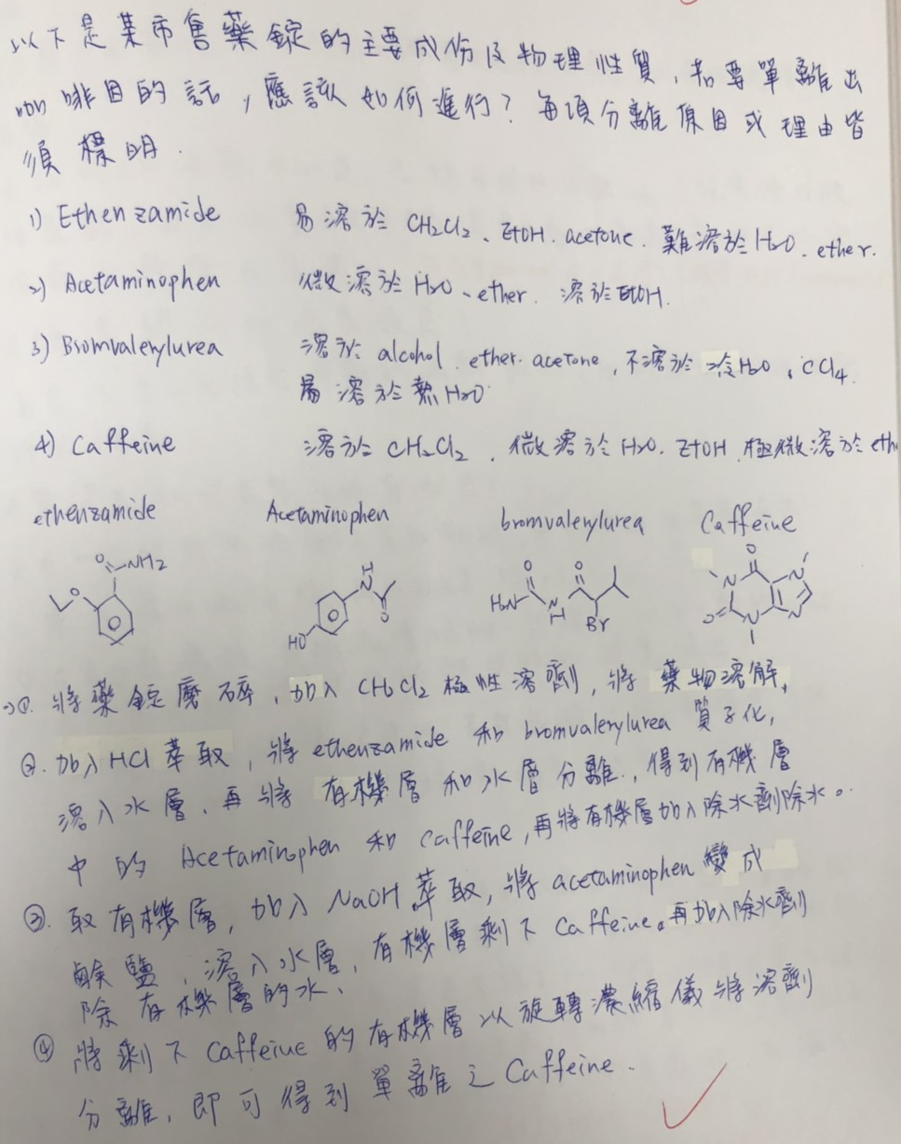
Extra Q2
以下是某市售藥錠的主要成分及物理性質，若要單離出咖啡因的話，應該如何進行? 每項分離原因或理由都須標明!
1) Ethenzamide…300mg ：易溶於二氯甲烷、乙醇、丙酮，難溶於水、乙醚。
2) Acetaminophen…200mg：微溶於水及乙醚，溶於酒精。
3) Bromvalerylurea…100mg：溶於醇、醚、丙酮，不溶於冷水，易溶於熱水，不溶於氯仿。
4) Caffeine…120mg：溶於二氯甲烷，微溶於水及酒精，極微溶於乙醚。

Slide 25
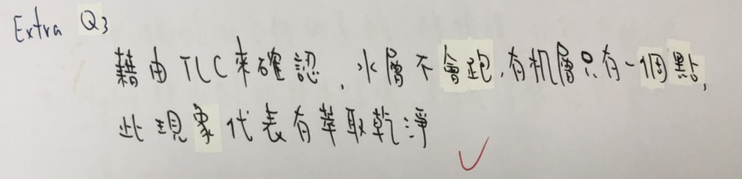
Extra Q3
如何確認在萃取實驗中有完全萃取乾淨，以避免造成產率損失?

Slide 26
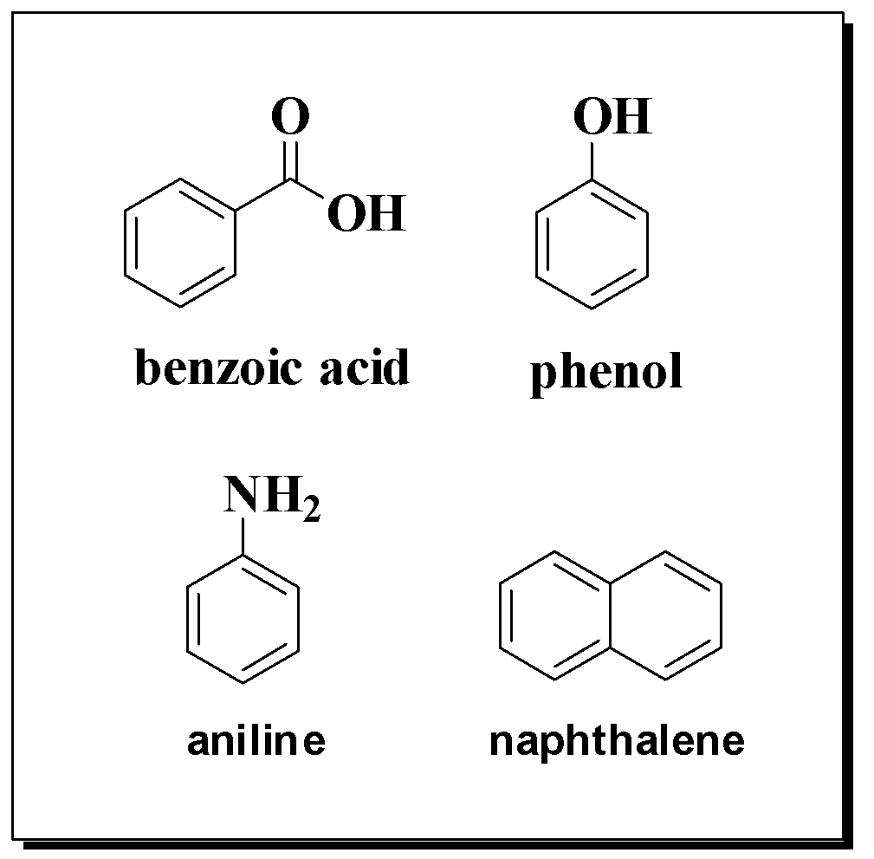
請使用下列藥品 寫下分離benzoic acid、phenol、aniline、naphthalene混合物的樹狀圖。 Draw a flow sheet for the separation of benzoic acid、phenol、aniline、naphthalene.
3M NaOH
6M NaOH
NaHCO_{3(aq)}
3M HCl
12M HCl
DCM
MgSO₄

Slide 27
*請全程戴口罩及安全眼鏡!
Experiment 5
Chromatography on Silica Gel and Alumina
目的
了解管柱色層分析法的應用及其操作。
乾填與濕填的方法。
利用薄層色層分析結果進行混合物的管柱分析法分離。
IR

Slide 28
Questions
4. Once the chromatographic column has been prepared, why is it important to allow the level of the liquid in the column to drop to the level of the alumina before applying the solution of the compound to be separated?
5. A chemist started to carry out column chromatography on a Friday afternoon, reached the point at which the two compounds being separated were about three-fourths of the way down the column, and then returned on Monday to find that the compounds came off the column as a mixture. Speculate the reason for this. The column had not run dry over the weekend.
EXTRA Q1TLC是否可以模擬COLUMN的情況，差異在哪?。
EXTRA Q2做管柱進行分離的溶劑選擇該思考的因素有哪些??!!(要寫原因喔!)
EXTRA Q3若產物與副產物MIX在一起該如何修正分離條件?

Slide 29
4. Once the chromatographic column has been prepared, why is it important to allow the level of the liquid in the column to drop to the level of the alumina before applying the solution of the compound to be separated?
Ans: The mixture to be separated should be in the minimum volume of solvent. If it is not, the bands of compounds down through the column will be wide, and separation will be poor.

Slide 30
5. Achemist started to carry out column chromatography on a Friday afternoon, reached the point at which the two compounds being separated were about three-fourths of the way down the column, and then returned on Monday to find that the compounds came off the column as a mixture. Speculate the reason for this. The column had not run dry over the weekend.
Ans: Over a period of time the material in a narrow band on the column can diffuse both up and down the column, carried by convection currents in the liquid of the column. This would cause narrow bands to overlap with adjacent bands with a consequent loss of resolution.

Slide 31
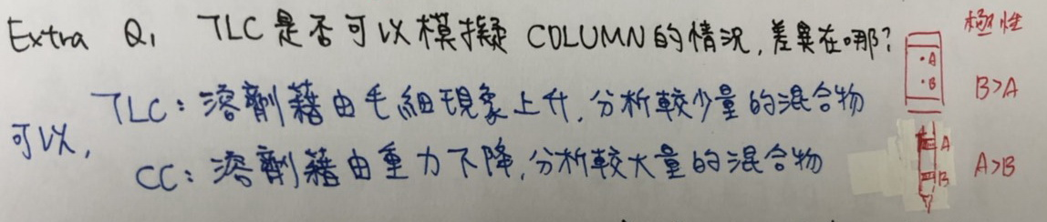
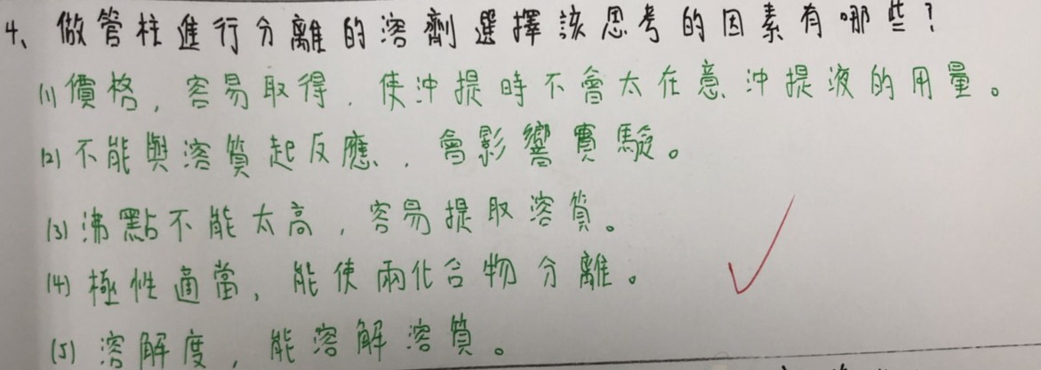
EXTRA Q1TLC是否可以模擬COLUMN的情況，差異在哪?。
EXTRA Q2做管柱進行分離的溶劑選擇該思考的因素有哪些??!!(要寫原因喔!)

Slide 32
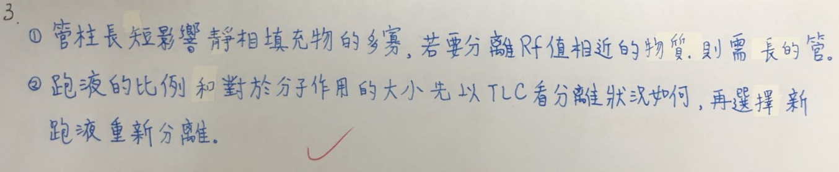
EXTRA Q3若產物與副產物MIX在一起該如何修正分離條件?

Slide 33
Column chromatography
1.(40%)寫出Column Packing的流程。Decribe the procedure of Column Packing.
2.(40%)寫出流Column的流程(若欲分離A,B兩化合物，極性:A>B)。 Decribe the procedure of Column Running (If there are two compounds, A and B, needed to be separated. Polarity:A>B).
3.(20%)寫出清理Column 的流程。 Decribe the procedure of Column Cleaning.

Slide 34
Experiment 6 Diels-Alder Reactions
實驗目的
1.使用迴流系統。
2.利用顯色劑點片。

Slide 35
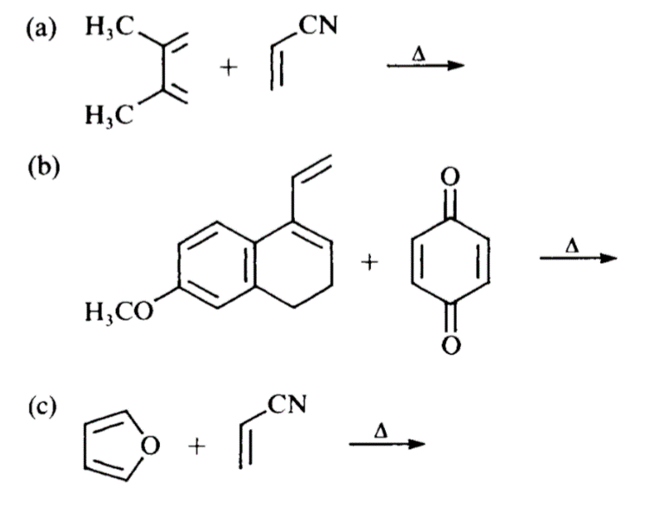
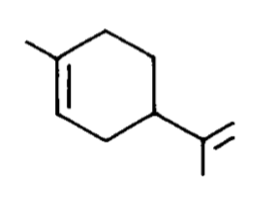
Questions
2. Draw the products of the following reactions:
3. What starting material would be necessary to prepare the following compound by the Diels–Alder reaction?
EXTRA Q1 為什麼不利用減壓濃縮將toluene抽掉?
EXTRA Q2本次TLC使用的KMnO4顯影劑，觀察到什麼TLC現象?其顯影機制是什麼? 有其他顯影劑嗎? 是應用在哪些化合物上? 經由本次實作TLC結果，你會怎麼再進行純化?
EXTRA Q3經由本次D-A實驗，爾後在進行此類反應時，你會考慮哪些條件以利反應?

Slide 36
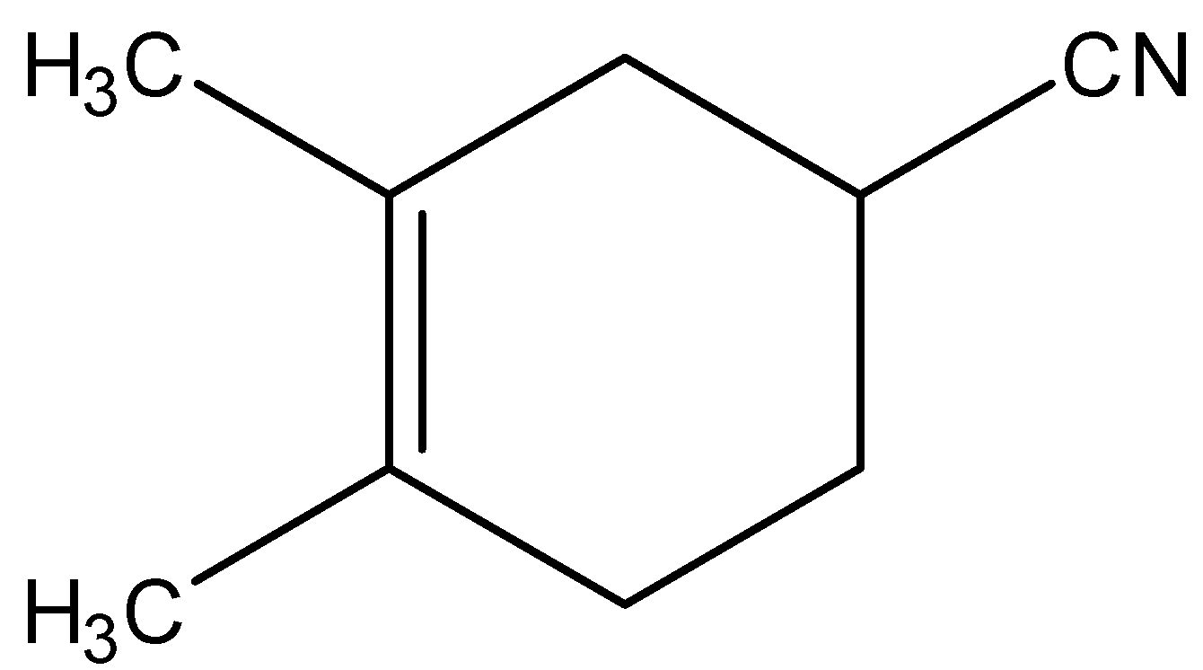
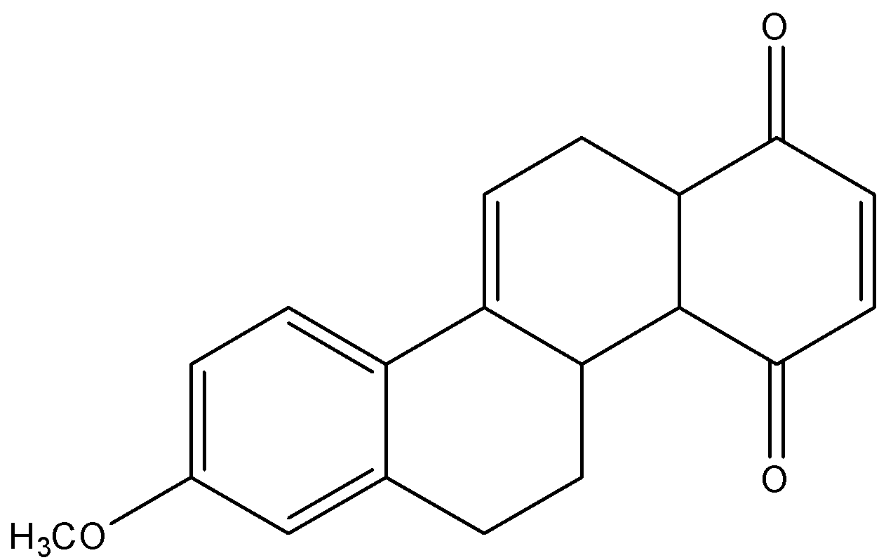
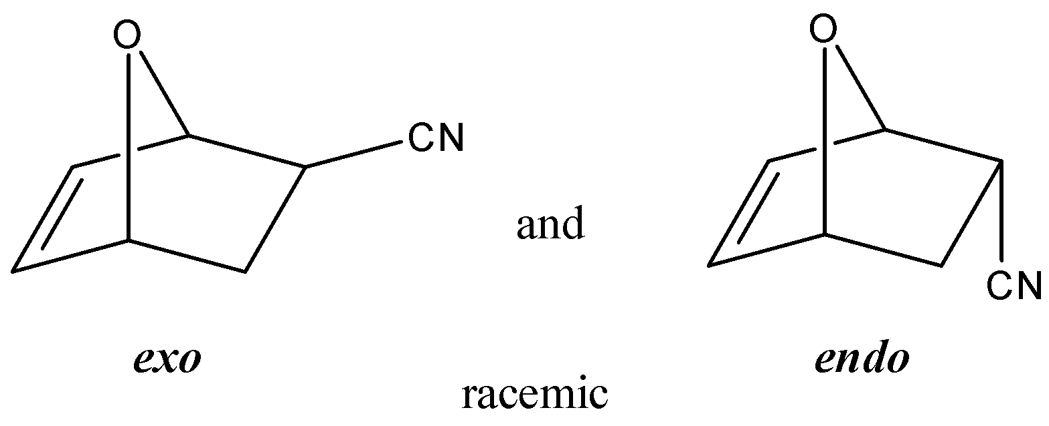
2. Draw the products of the following reactions:

Slide 37
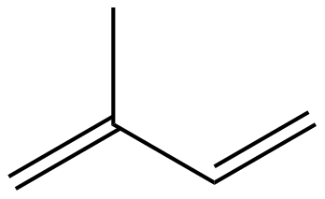
3. What starting material would be necessary to prepare the following compound by the Diels–Alder reaction?
Two molecules of 2-methyl-1,3-butadiene

Slide 38
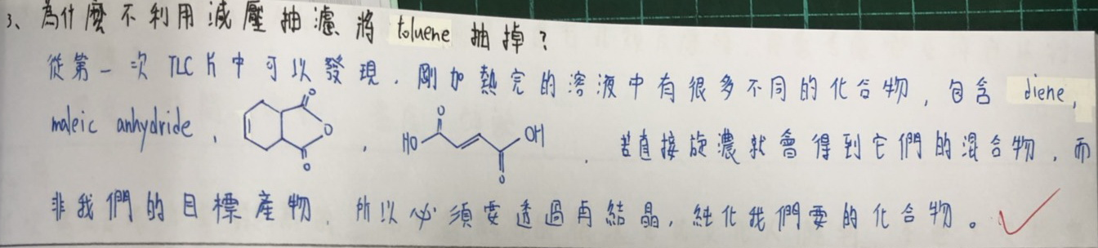
EXTRA Q1 為什麼不利用減壓濃縮將toluene抽掉?

Slide 39
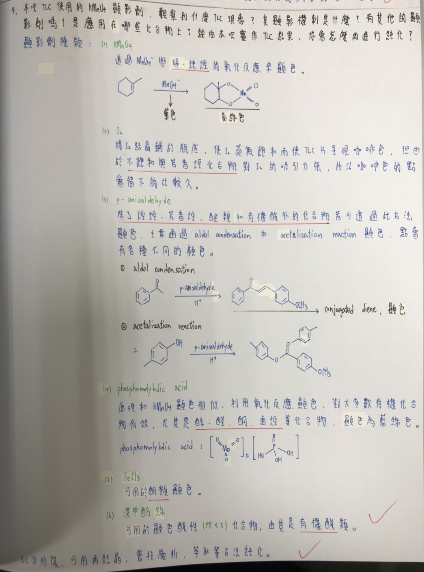
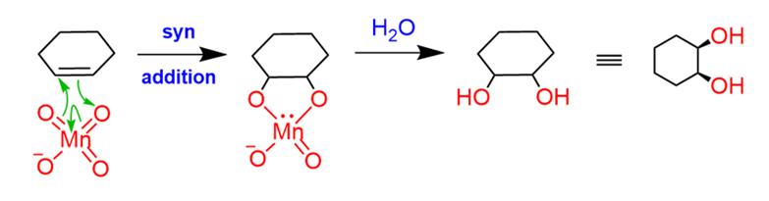
EXTRA Q2本次TLC使用的KMnO4顯影劑，觀察到什麼TLC現象?其顯影機制是什麼? 有其他顯影劑嗎? 是應用在哪些化合物上? 經由本次實作TLC結果，你會怎麼再進行純化?

Slide 40
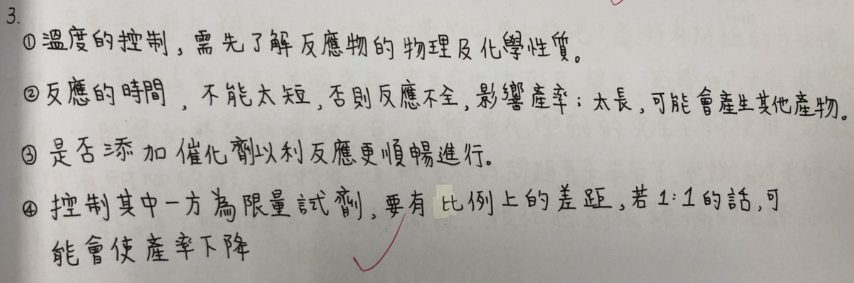
EXTRA Q3經由本次D-A實驗，爾後在進行此類反應時，你會考慮哪些條件以利反應?

Slide 41
Diels-Alder Reactions
問題回答：
反應過程中會產生哪種氣體? 有無毒害? In this experiment, heating 3-sulfolene produces 1,3-butadiene and a gas. What gas is evolved and is it toxic?
反應中出現的沉澱物是什麽? What is the precipitate that produces in the reaction?
反應物中哪個是限量試劑？ Which of the reactants is a limited reagent?

Slide 42
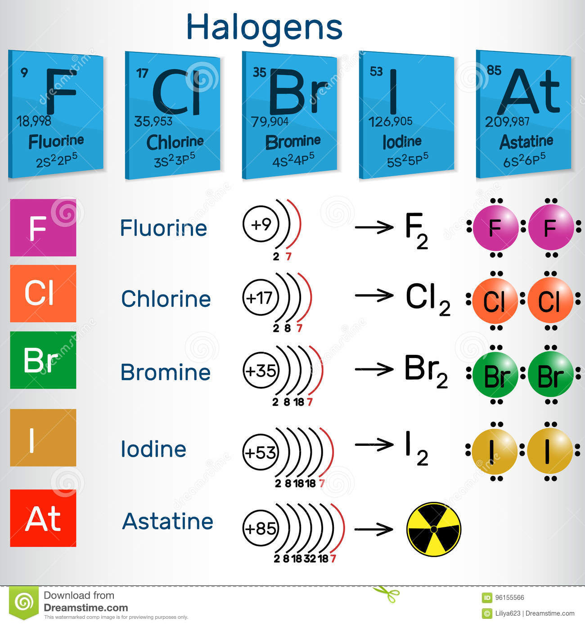
Experiment 7 Halogenation Reaction
實驗目的:
瞭解色鹵化反應及其應用性
了解離去基在取代反應中扮演的角色

Slide 43
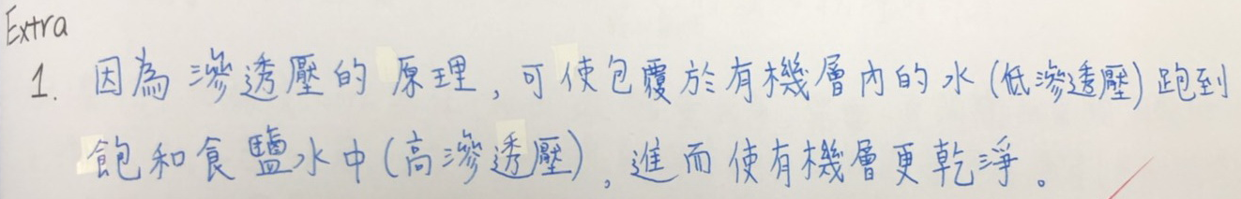
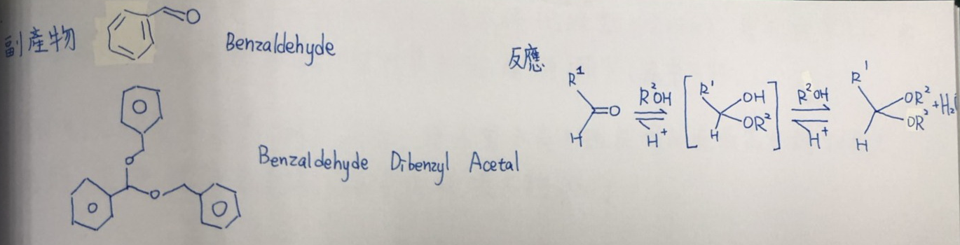
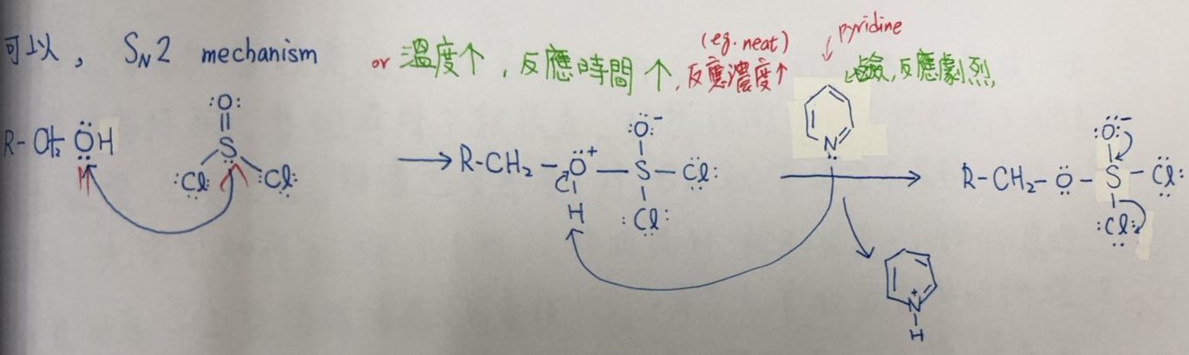
Questions
EXTRA Q1鹽洗(Brine wash)的目的為何?
EXTRA Q2此反應可能有哪些副產物?或副反應發生?
EXTRA Q3若不加DMF反應是否可以進行?需要改變甚麼反應條件?

Slide 44
(30%)寫出Thionyl chloride與DMF作用之反應機構。Write the mechanism of thionyl chloride reacting with DMF
(20%)寫出Thionyl chloride與水反應之反應方程式Write the chemical equation of thionyl chloride reacting with water.
(20%)如何確認反應是否結束? How can you confirm if the reaction is over?
(30%)為何不此反應不可用NaHCO₃酸鹼中和來萃息反應?如何終止反應?Why can not quench the reaction with NaHCO₃? How to quench the reaction?

Slide 45
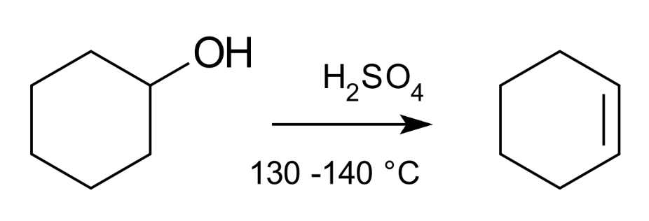
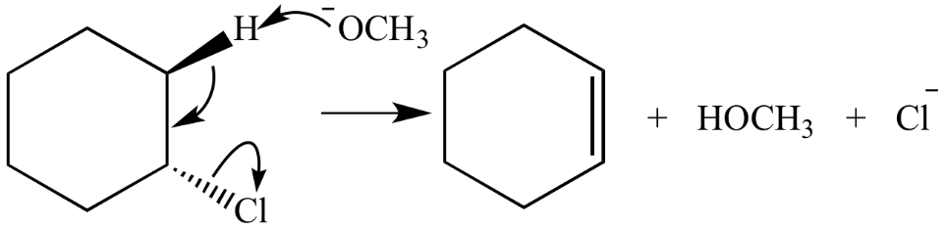
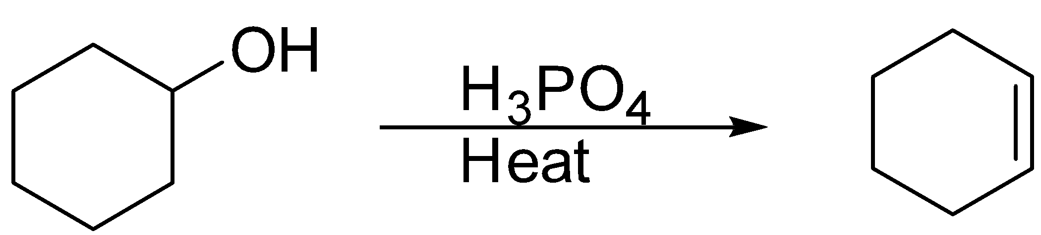
Experiment 8 Elimination Reaction
實驗目的:
瞭解消除反應及其應用性。

Slide 46
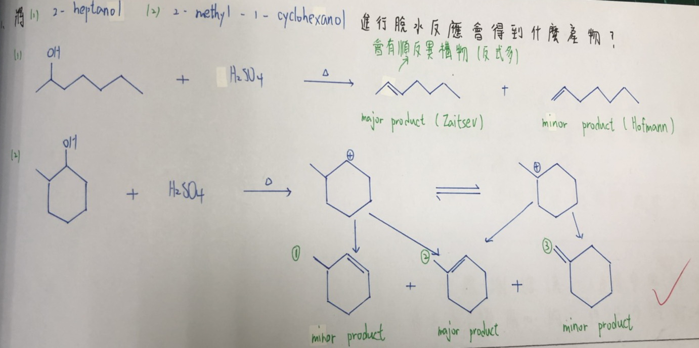
Questions
2. Which product(s) would be obtained by the dehydration of 2-heptanol and of 2-methyl-l-cyclohexanol?

Slide 47
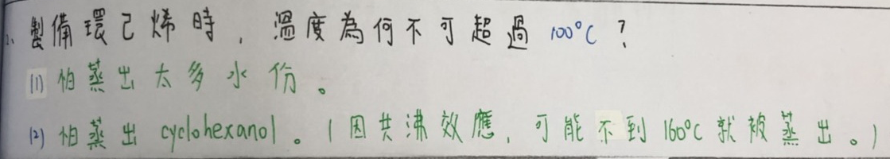
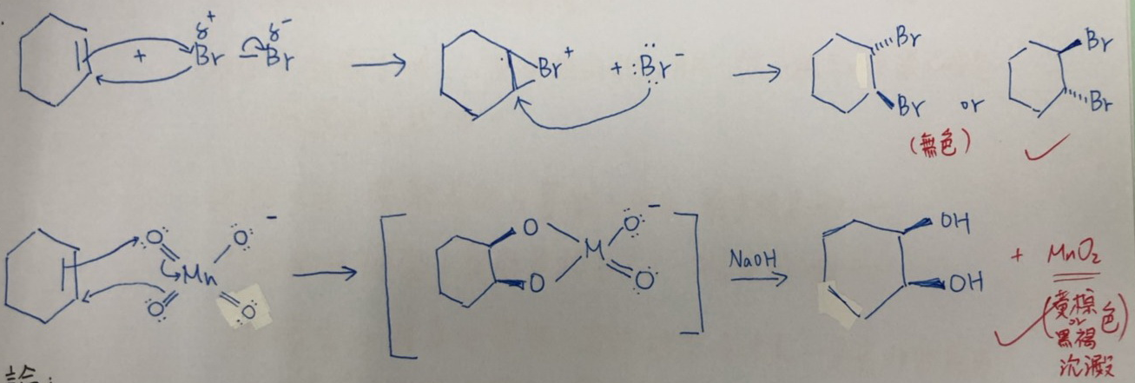
EXTRA Q1製備環己烯時，為何蒸餾的溫度不可超過100 ºC?
EXTRA Q2 最後利用Br₂及KMnO₄做測試所得結果的反應機制分別為何?

Slide 48
(40%)請寫出本次實驗的反應機構Please write the reaction mechanism of this experiment.
(20%)製備環己烯時，為何蒸餾的溫度不可超過100 ºC? When preparing cyclohexene, why does the temperature during the distillation cannot exceed 100 ºC ?
(20%)為何不利用一般的萃取方式再利用減壓濃縮將溶解產物之有機溶劑抽離掉? Why not use the general extraction method and remove the organic solvent that used to dissolved product by rotary evaporator?
(20%)在進行微量過濾時，氯化鈣不能夠加太多，理由為何? What is the reason that calcium chloride cannot be added too much during microfiltration?
(20%)寫出講師及3位助教的名字☺Write the names of the instructor and the three teaching assistants.

